Slide 1

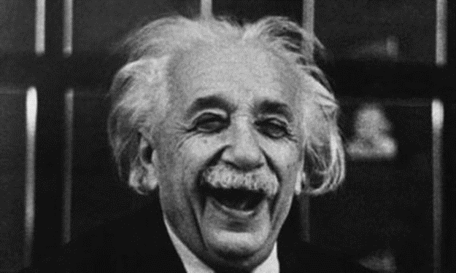
Special
Relativity

Slide 2
Key objectives
Definition of inertial frame of reference.
The special theory of relativity is based on two postulates: that the speed of light in a vacuum is an absolute constant, and that all inertial reference frames are equivalent.
Einstein’s special theory of relativity predicts significantly different results to those of Newtonian physics for velocities approaching the speed of light.
Motion can only be measured relative to an observer.
Time is a relative quantity that depends on the observer’s frame of reference.
Length is a relative quantity that depends on the observer’s frame of reference.

Slide 3

Equations
Time dilation:
$$t=\frac{t_{o}}{\sqrt{1−\frac{v^{2}}{c^{2}}}}$$
Length contraction:
$$l=l_{o}\sqrt{1−\frac{v^{2}}{c^{2}}}$$

Slide 4
Text References
STAWA pages 180-193
  Set 14.1
  Set 14.2
Step Up in Education
  4.1 Postulates of Special Relativity

Slide 5
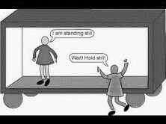
Inertial frame of reference
An inertial frame of reference is a frame of reference in which Newton’s first law applies.
Any frame of reference that moves at a constant velocity relative to an inertial frame of reference is also an inertial frame of reference.
Any frame of reference that accelerates relative to an inertial frame of reference is NOT an inertial frame of reference.

Slide 6
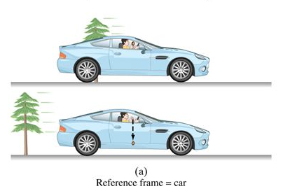
Relativity deals with experiments observed from different reference frames.
Take a scenario where you are in a car travelling at a constant velocity.
If you release a coin from above your head inside the car, it will fall straight downward with respect to the car and hits the floor of the car directly below its point of release.
Now think about the same scenario from the perspective of someone outside of the car…
what path does the coin take?

Slide 7
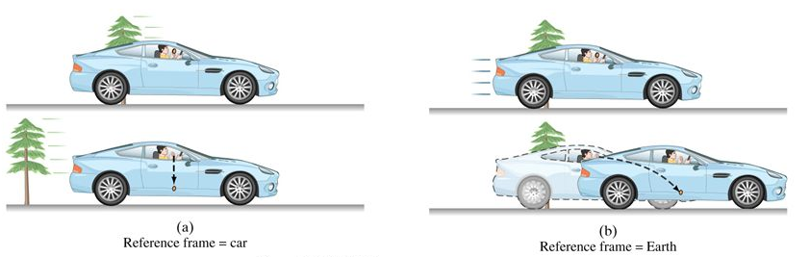
In the reference frame of someone watching on from a stationary position outside the car, the coin is moving with an initial velocity and follows a projectile path.
The laws of physics are the same in all inertial frames, the same law of gravity, the same laws of motion, the magnitude of the acceleration is the same.
The laws of physics are the same in both reference frames, although the specific paths are different.
That the laws of mechanics are the same in all inertial reference frames implies no one inertial frame is special – all inertial reference frames are equivalent.

Slide 8
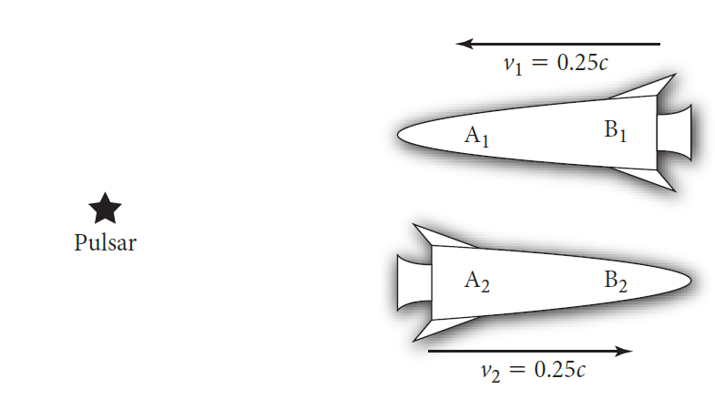
Postulates of special relativity
First postulate (the relativity principle): The laws of physics have the same form in all inertial reference frames.
Second postulate (constancy of the speed of light): Light propagates through empty space with a definite speed c independent of the speed of the source or the observer.

Slide 9
Simultaneity
Two events are said to occur simultaneously if they occur at exactly the same time. But how do we know if you events occur at precisely the same time?
It is easy to determine if they occur at the same time is they occur at the same point in space (for example: two apples falling on your head).
If the two events are widely separated we need to take into account the time it takes for the light from the event to each us.
This means that if any observer sees two events as happening at the exact same time, but one occurs at a much greater distance than the other, then the event at a greater distance took place first, therefore the event are not simultaneous.

Slide 10
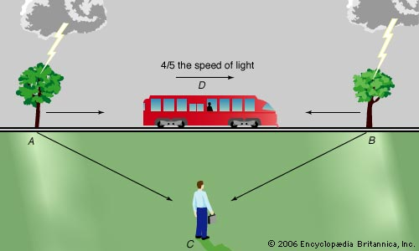
If two events are simultaneous to an observer in one reference frame, are they also simultaneous to another observer moving with respect to the first?
The answer is that different observers can disagree about whether or not two events have happened at the same time.
A common thought experiment on this question involves two lightning bolts hitting the opposite sides of a train.
The two lightning strikes are simultaneous to the observer at rest, but the observer moving with the train sees the lightning strike the front of the train first.

Slide 11
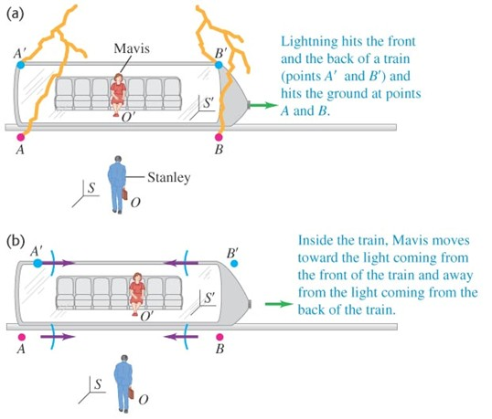

Slide 12
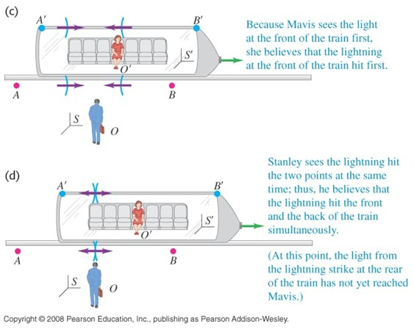

Slide 13
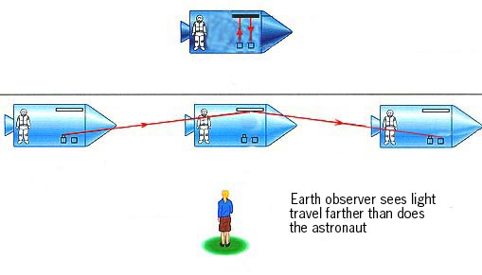
Time dilation
The fact that two events simultaneous to one observer may not be simultaneous to a second observer suggest that time itself is not absolute.
Einstein’s theory of relativity predicts that time passes differently in one reference frame than in another.
A thought experiment for time dilation uses the example of a spacecraft travelling past Earth at high speed, observed by someone on Earth. If they both have accurate clocks and are observing the same light reflecting event, how will the time vary?

Slide 14
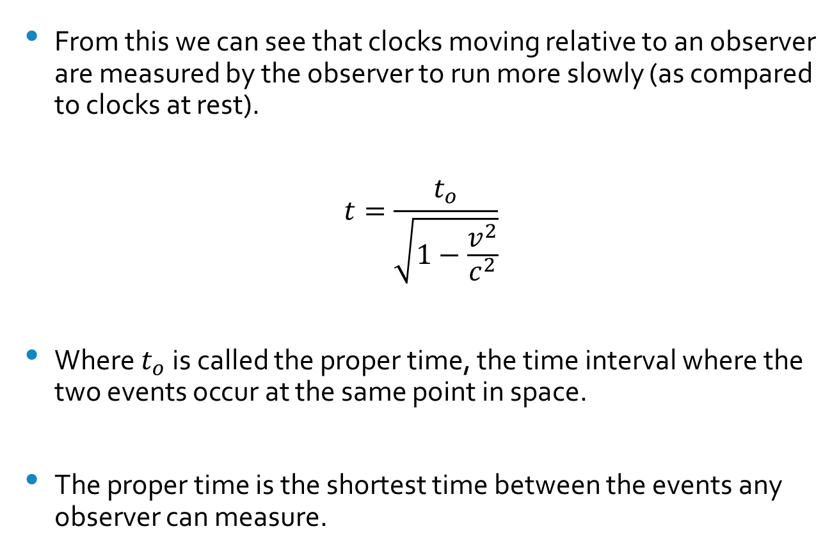
From this we can see that clocks moving relative to an observer are measured by the observer to run more slowly (as compared to clocks at rest).
$$t=\frac{t_{o}}{\sqrt{1−\frac{v^{2}}{c^{2}}}}$$
Where $t_{o}$ is called the proper time, the time interval where the two events occur at the same point in space.
The proper time is the shortest time between the events any observer can measure.

Slide 15
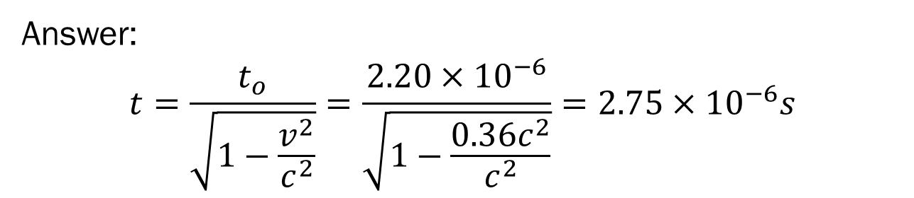
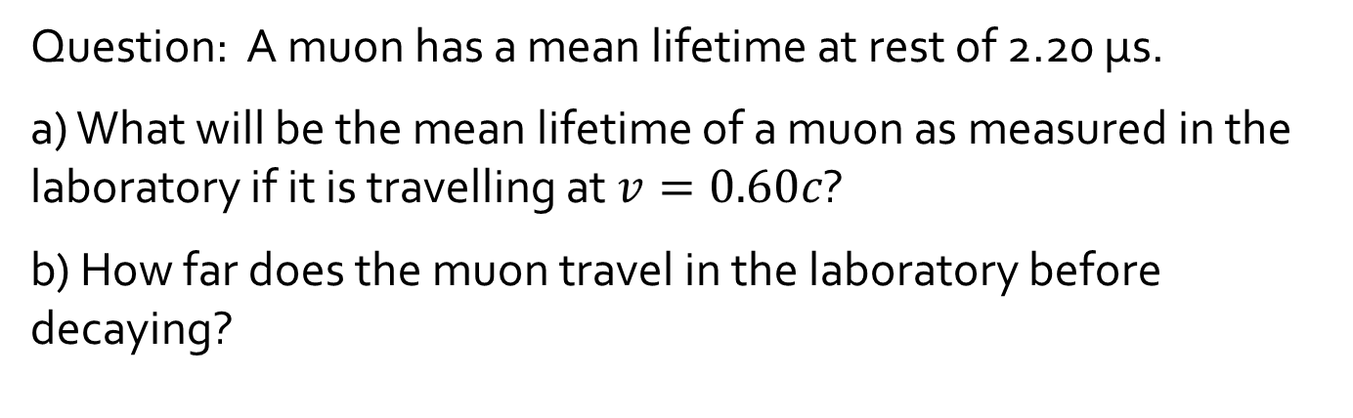
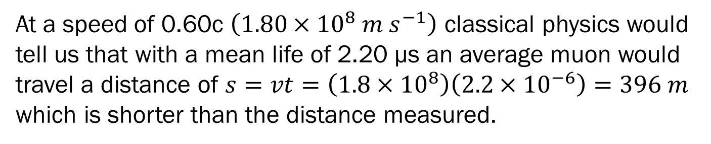
Question: A muon has a mean lifetime at rest of 2.20 µs.
a) What will be the mean lifetime of a muon as measured in the laboratory if it is travelling at $v=0.60c$?
b) How far does the muon travel in the laboratory before decaying?
Answer:
$$t=\frac{t_{o}}{\sqrt{1−\frac{v^{2}}{c^{2}}}}=\frac{2.20×{10}^{−6}}{\sqrt{1−\frac{{0.36c}^{2}}{c^{2}}}}=2.75×{10}^{−6}s$$
$$s=vt=0.6\left(3×{10}^{8}\right)\left(2.75×{10}^{−6}\right)=495m$$
At a speed of 0.60c $\left(1.80×{10}^{8} m s^{−1}\right)$ classical physics would tell us that with a mean life of 2.20 µs an average muon would travel a distance of $s=vt=\left(1.8×{10}^{8}\right)\left(2.2×{10}^{−6}\right)=396 m$ which is shorter than the distance measured.

Slide 16
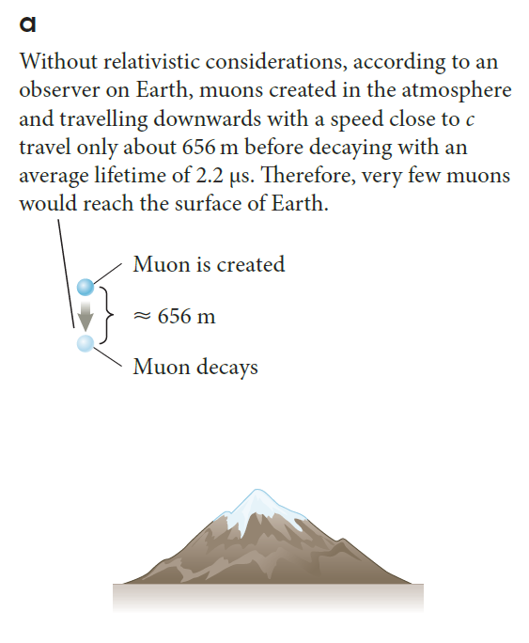
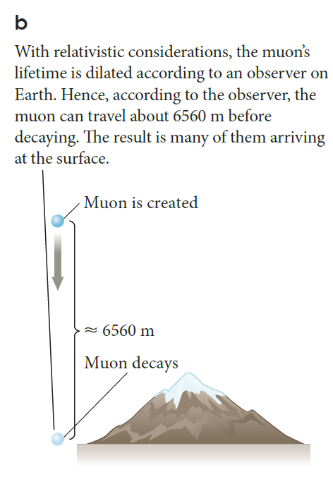

Slide 17


Question: A certain type of elementary particle travels at a speed of $2.70×{10}^{8} m s^{−1}.$ At this speed, the average life-time is measured to be $4.76×{10}^{−6}s$. What is the particles lifetime at rest?
Answer:
$t=\frac{t_{o}}{\sqrt{1−\frac{v^{2}}{c^{2}}}}$ so $t_{o}=t\sqrt{1−\frac{v^{2}}{c^{2}}}$
$$t_{o}=t\sqrt{1−\frac{v^{2}}{c^{2}}}=\left(4.76×{10}^{−6}\right)\sqrt{1−\frac{{\left(2.70×{10}^{8}\right)}^{2}}{{\left(3×{10}^{8}\right)}^{2}}}$$
$$t_{o}=2.07×{10}^{−6} s$$

Slide 18
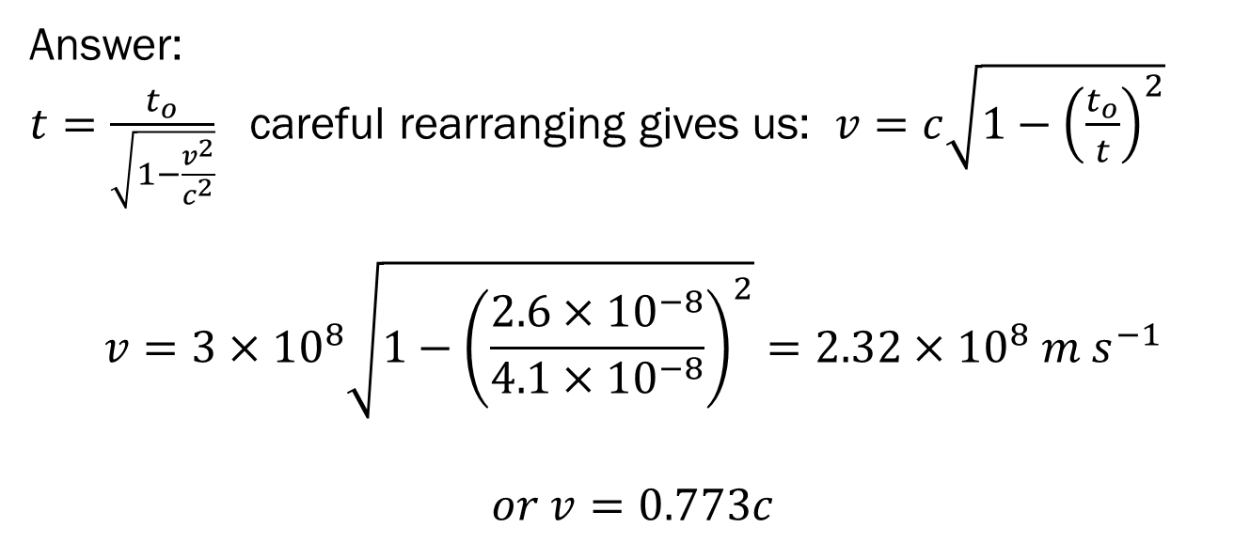
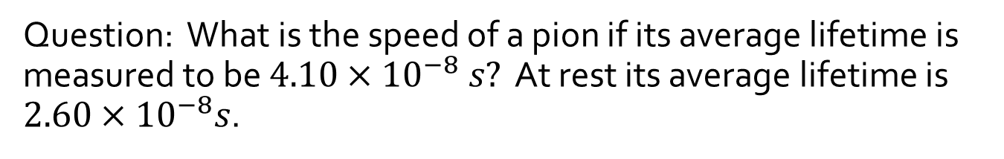
Question: What is the speed of a pion if its average lifetime is measured to be $4.10×{10}^{−8} s?$ At rest its average lifetime is $2.60×{10}^{−8}s$.
Answer:
$t=\frac{t_{o}}{\sqrt{1−\frac{v^{2}}{c^{2}}}}$ careful rearranging gives us: $v=c\sqrt{1−{\left(\frac{t_{o}}{t}\right)}^{2}}$
$$v=3×{10}^{8}\sqrt{1−{\left(\frac{2.6×{10}^{−8}}{4.1×{10}^{−8}}\right)}^{2}}=2.32×{10}^{8} m s^{−1}$$
$$or v=0.773c$$

Slide 19
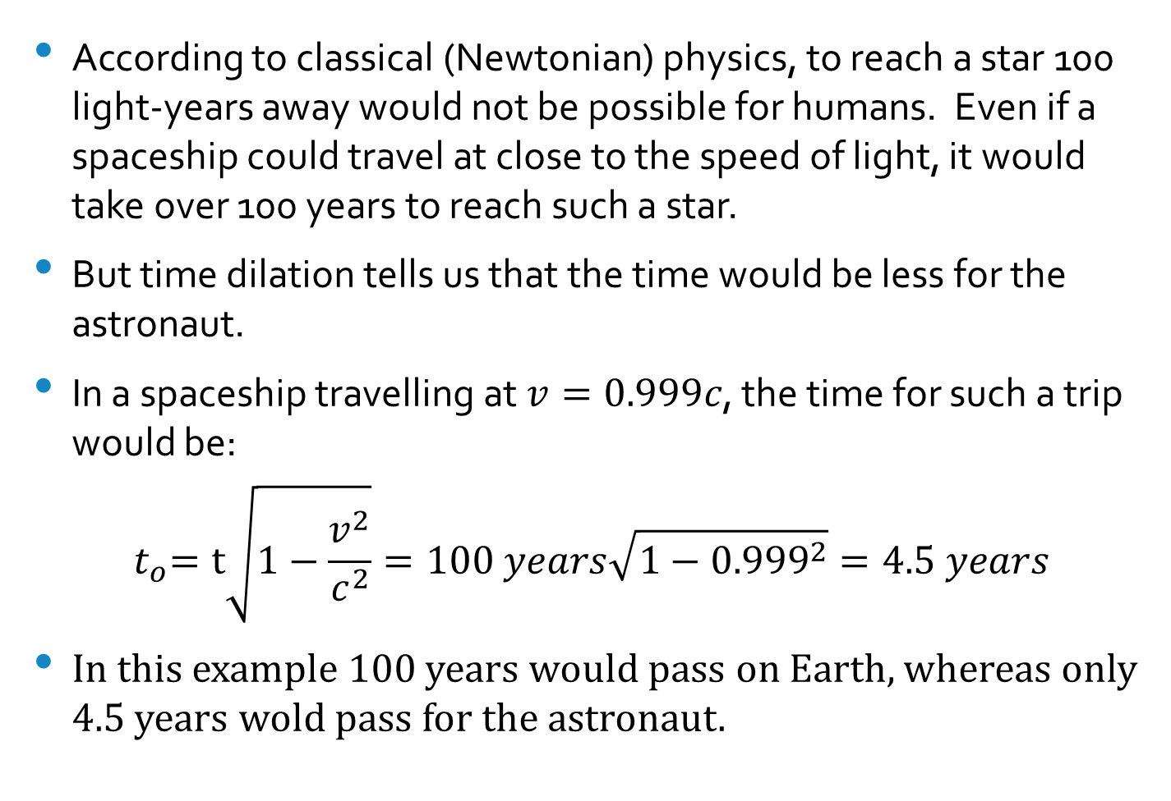
Space travel
According to classical (Newtonian) physics, to reach a star 100 light-years away would not be possible for humans. Even if a spaceship could travel at close to the speed of light, it would take over 100 years to reach such a star.
But time dilation tells us that the time would be less for the astronaut.
In a spaceship travelling at $v=0.999c$, the time for such a trip would be:
$${ t}_{o}=t\sqrt{1−\frac{v^{2}}{c^{2}}}=100 years\sqrt{1−{0.999}^{2}}=4.5 years$$
In this example 100 years would pass on Earth, whereas only 4.5 years wold pass for the astronaut.

Slide 20
Twin Paradox
The twin paradox is as follows: suppose one of a pair of 20 year old twins takes off in a spaceship travelling at a very high speed to a distant star and back, while the other twin remains on Earth.
According to the twin on Earth, the astronaut will age less. So when the astronaut returns to Earth she could be 20 years younger than the Earthbound twin.
This is from the viewpoint on the twin on Earth. But if all inertial frames of reference are equally valid, won’t the astronaut twin be able to make the same claims about the Earth twin, but in reverse?
The astronaut twin can claim that the Earth is the one travelling away at a high speed and the Earthbound twin will age less as a consequence… So who is right?

Slide 21
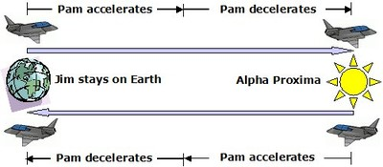
Twin ‘paradox’: solved
There is not actually a contradiction here – the fact is that the spaceship is not always in an inertial frame of reference!
The spacecraft accelerates at the start and the end of the journey, and when it turns around. During the time it accelerates the twin on the spacecraft is not in an inertial frame of reference, so she cannot predict the relative ages when she returns. The Earth twin stays in an inertial frame of reference so her predictions will be correct.

Slide 22
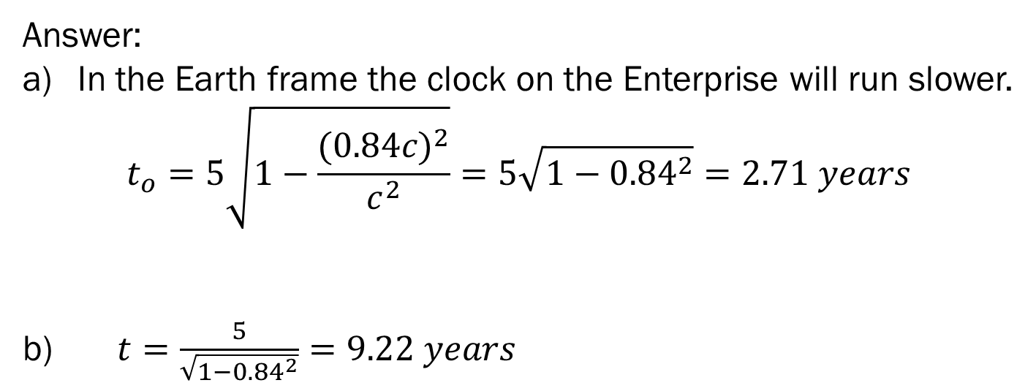
Question: A news report stated that the starship enterprise had just returned from a 5 year voyage whilst travelling at 0.84 c.
If the report meant 5 years Earth time, how much time has elapsed on the ship (in years)?
If the report meant 5 years ship time, then how much time elapsed on Earth (in years)?
Answer:
In the Earth frame the clock on the Enterprise will run slower.
$$t_{o}=5\sqrt{1−\frac{{(0.84c)}^{2}}{c^{2}}}=5\sqrt{1−{0.84}^{2}}=2.71 years$$
b) $t=\frac{5}{\sqrt{1−{0.84}^{2}}}=9.22 years$

Slide 23
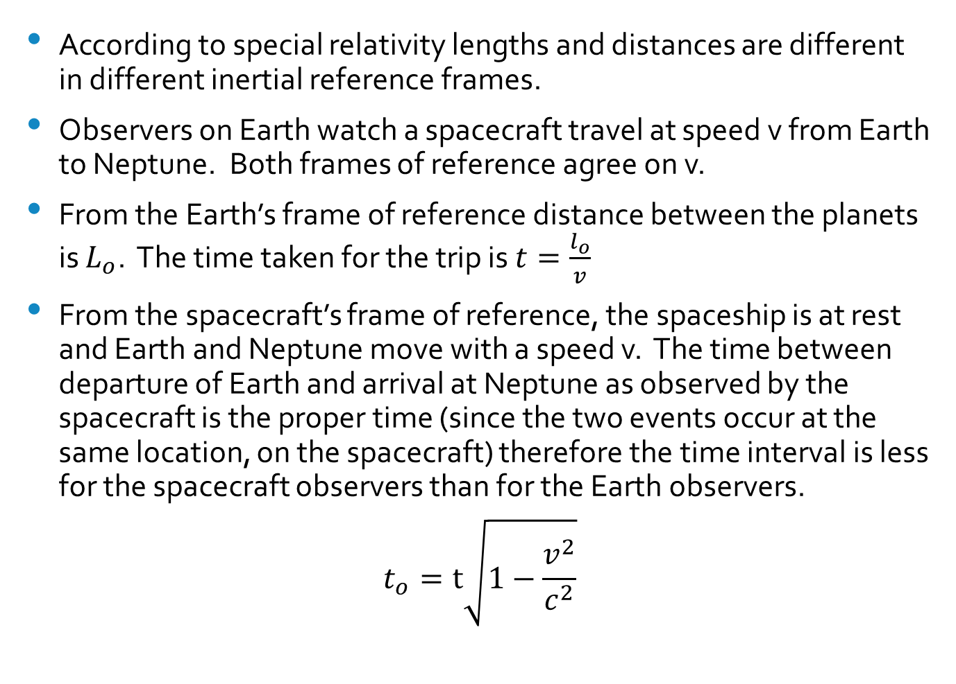
Length Contraction
According to special relativity lengths and distances are different in different inertial reference frames.
Observers on Earth watch a spacecraft travel at speed v from Earth to Neptune. Both frames of reference agree on v.
From the Earth’s frame of reference distance between the planets is $L_{o}$. The time taken for the trip is $t=\frac{l_{o}}{v}$
From the spacecraft’s frame of reference, the spaceship is at rest and Earth and Neptune move with a speed v. The time between departure of Earth and arrival at Neptune as observed by the spacecraft is the proper time (since the two events occur at the same location, on the spacecraft) therefore the time interval is less for the spacecraft observers than for the Earth observers.
$$t_{o}=t\sqrt{1−\frac{v^{2}}{c^{2}}}$$

Slide 24
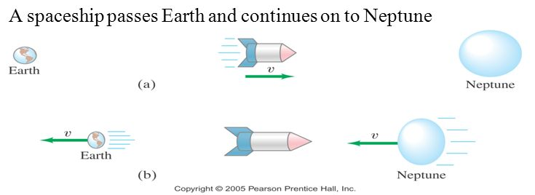
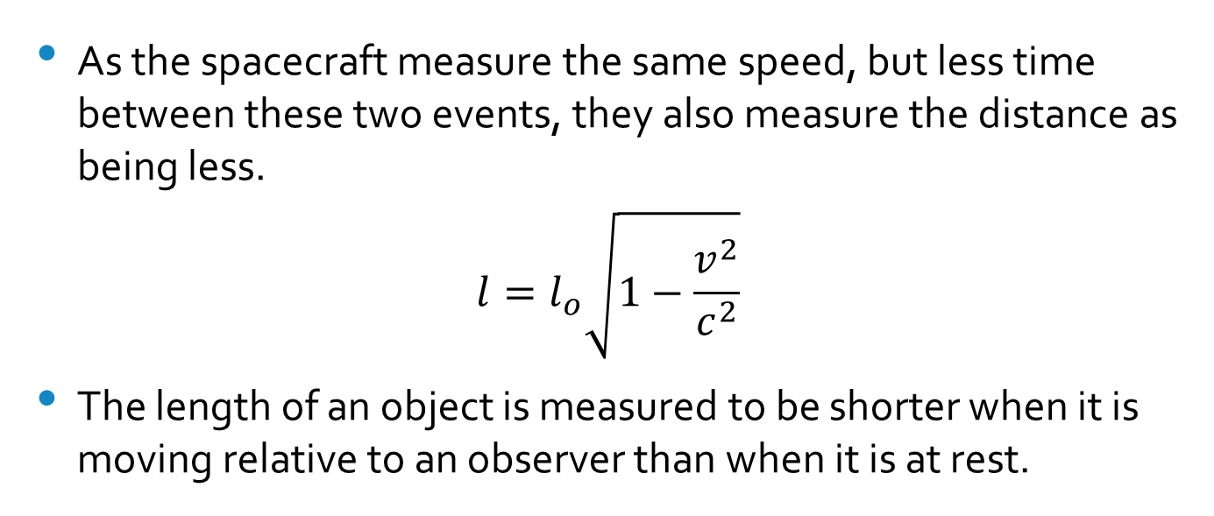
As the spacecraft measure the same speed, but less time between these two events, they also measure the distance as being less.
$$l=l_{o}\sqrt{1−\frac{v^{2}}{c^{2}}}$$
The length of an object is measured to be shorter when it is moving relative to an observer than when it is at rest.

Slide 25

Length contraction is only significant when the object is moving at relativistic speeds (speeds which are a significant fraction of the speed of light).
Spaceship Moving at the 10 % the Speed of Light
Spaceship Moving at the 86.5 % the Speed of Light
Spaceship Moving at the 99 % the Speed of Light

Slide 26
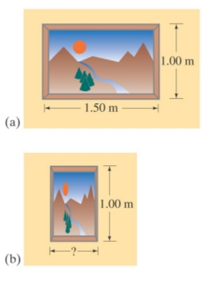
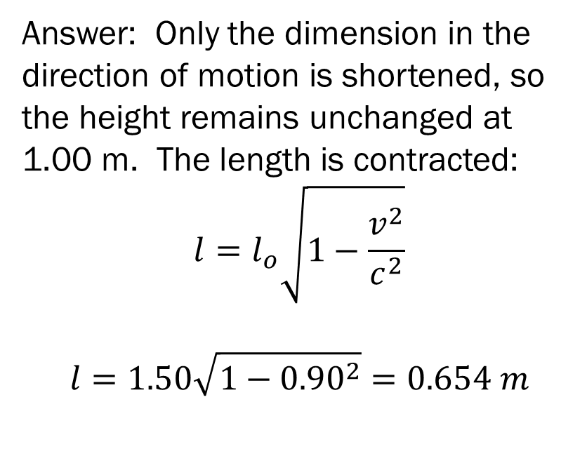
Question: A rectangular painting measures 1.00 m tall and 1.50 m wide. It is hung on the side wall of a spaceship which is moving past the Earth at a speed of 0.90 c. What are the dimensions of the painting as seen by an observer on the Earth?
Answer: Only the dimension in the direction of motion is shortened, so the height remains unchanged at 1.00 m. The length is contracted:
$$l=l_{o}\sqrt{1−\frac{v^{2}}{c^{2}}}$$
$$l=1.50\sqrt{1−{0.90}^{2}}=0.654 m$$

Slide 27
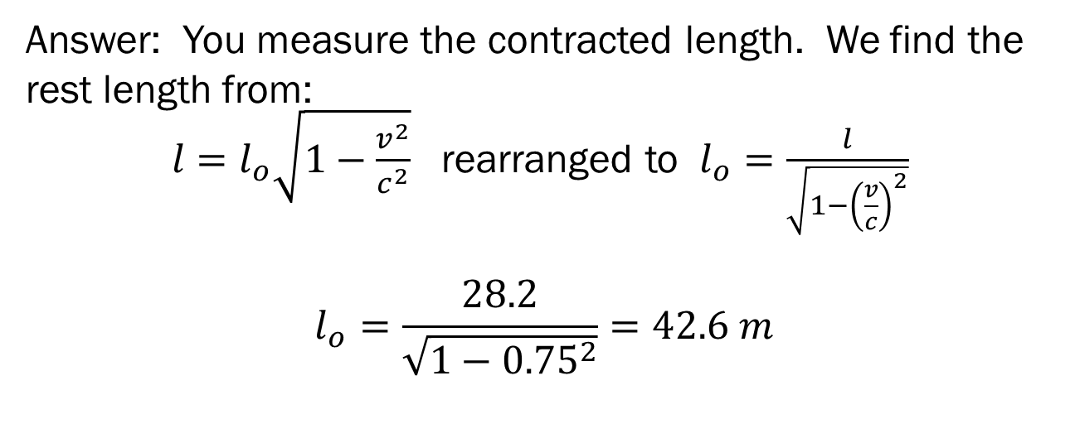
Question: A spaceship passes you at a speed of 0.75c. You measure its length to be 28.2 m.
How long would it be when at rest?
Answer: You measure the contracted length. We find the rest length from:
$l=l_{o}\sqrt{1−\frac{v^{2}}{c^{2}}}$ rearranged to $l_{o}=\frac{l}{\sqrt{1−{\left(\frac{v}{c}\right)}^{2}}}$
$$l_{o}=\frac{28.2}{\sqrt{1−{0.75}^{2}}}=42.6 m$$

Slide 28
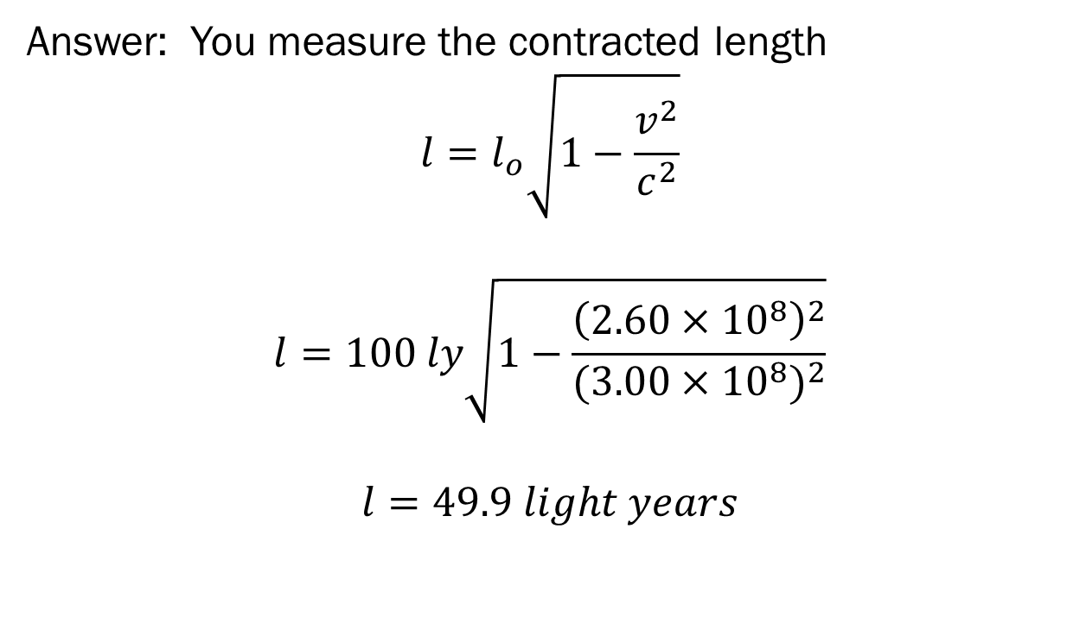
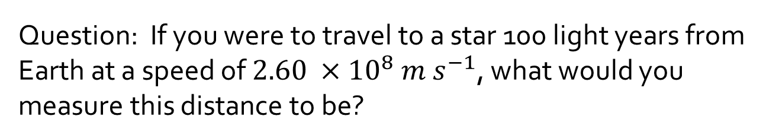
Question: If you were to travel to a star 100 light years from Earth at a speed of $2.60 ×{10}^{8} m s^{−1}$, what would you measure this distance to be?
Answer: You measure the contracted length
$$l=l_{o}\sqrt{1−\frac{v^{2}}{c^{2}}}$$
$$l=100 ly\sqrt{1−\frac{{\left(2.60×{10}^{8}\right)}^{2}}{{(3.00×{10}^{8})}^{2}}}$$
$$l=49.9 light years$$

Slide 29
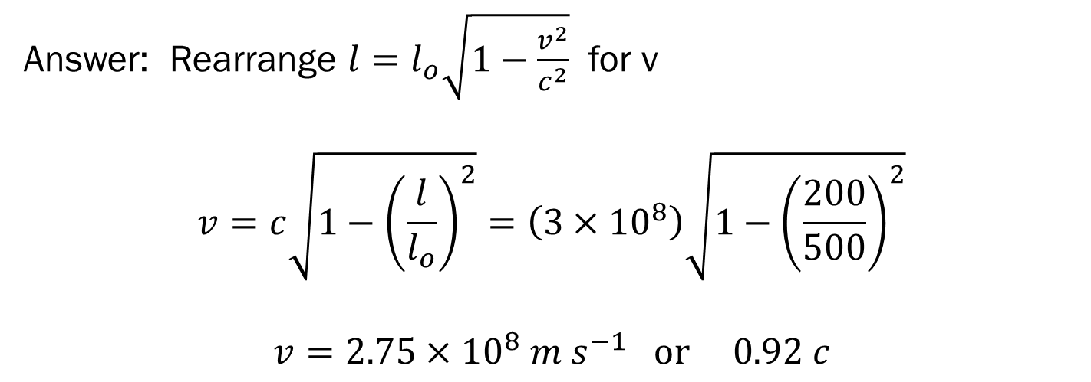
Fantasy super train
Question: A train with a length of 500 m is passing through a 200 m long tunnel. The train is travelling so fast that it fits completely within the tunnel as seen by an observer at rest on the Earth (the front of the train is just about to emerge from one end of the tunnel as the last car disappears into the other end. What is the speed of the train?
Approach: since the train just fits inside the tunnel, its length measured by the observer on the ground is 200 m. Solve for v…
Answer: Rearrange $l=l_{o}\sqrt{1−\frac{v^{2}}{c^{2}}}$ for v
$$v=c\sqrt{1−{\left(\frac{l}{l_{o}}\right)}^{2}}=\left(3×{10}^{8}\right)\sqrt{1−{\left(\frac{200}{500}\right)}^{2}}$$
$$v=2.75×{10}^{8} m s^{−1} or 0.92 c$$
Notes:
No real train could go this fast! And an observer on the train would not see the two ends of the train inside the tunnel at the same time; simultaneity is relative.

Slide 30
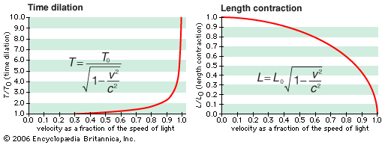
Graphing time dilation and length contraction

